Slide 1
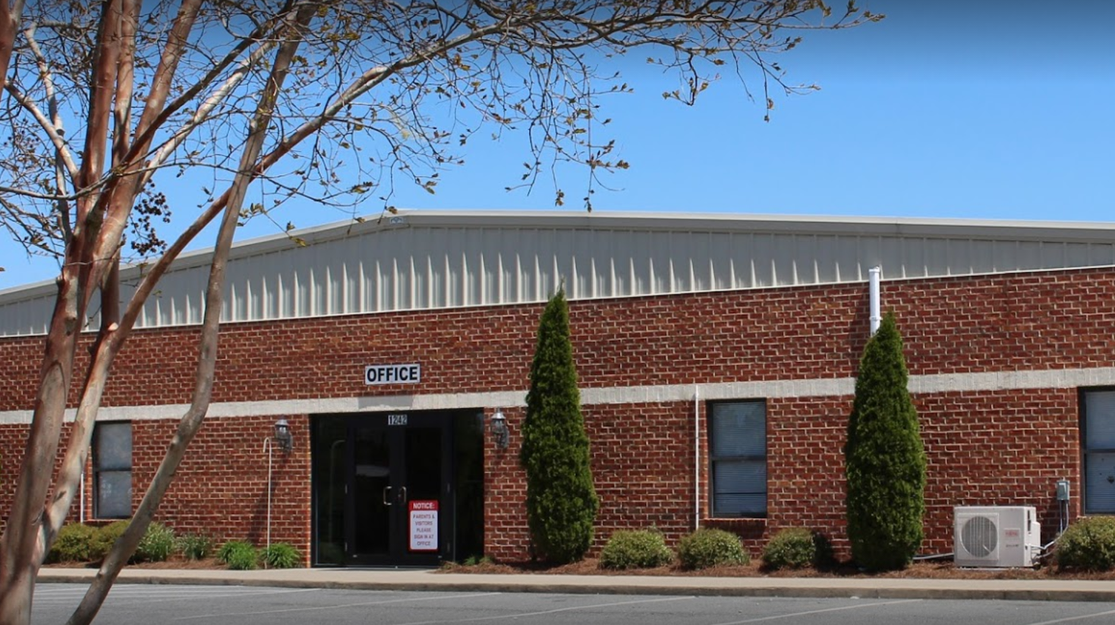
River Mill Academy
Virtual Tour

Slide 2
Background
One of the original five public charter schools in the state.
Founded in May of 1998 in Saxapahaw, on the banks of the Haw River.
Moved to Graham in 2003 and expanded on two separate occasions.
College preparatory curriculum aligned with the North Carolina Standard Course of Study.
Participates in all state mandated standardized testing.

Slide 3
Background
Kindergarten-12th grade public school houses approximately 850 students
Class sizes are capped at 24
School day starts from 7:45 for secondary students and 8:00 for elementary students
Dismissal is at 2:30

Slide 4
Elementary School
3 classes of 24 students per grade level.
Each classroom in grades K-3 have a full-time teacher assistant.
4th and 5th grades share a teacher assistant in each grade level.
Elementary classes “loop”, meaning students remain in the same class cohort for two full school years.
Each day students participate in 90 minutes of uninterrupted math and reading periods.
Students have 30 minutes of recess and at least one special each day.
Spanish, Art, Media (Library), Music and Physical Education

Slide 5
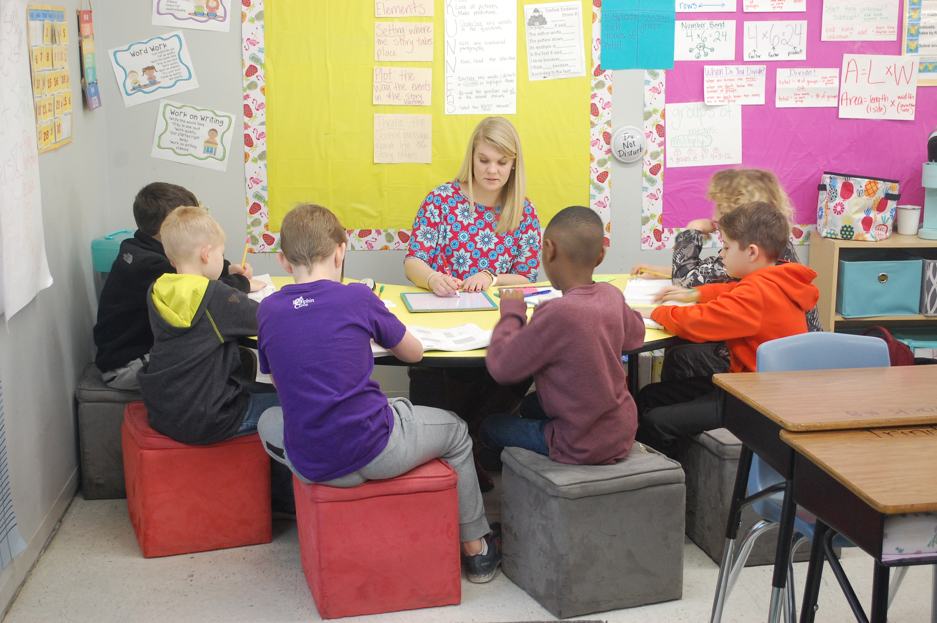
Small group instruction occurs every day

Slide 6
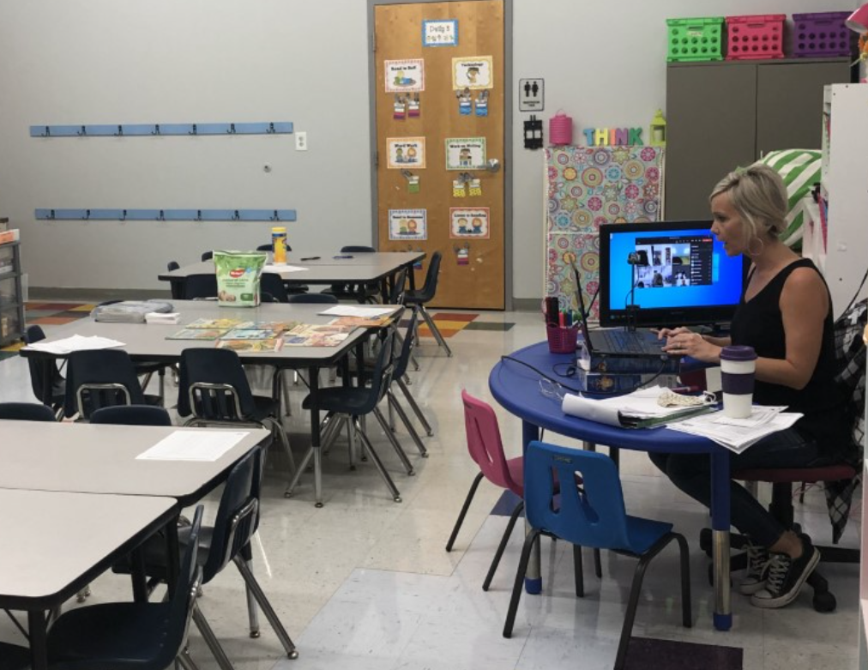
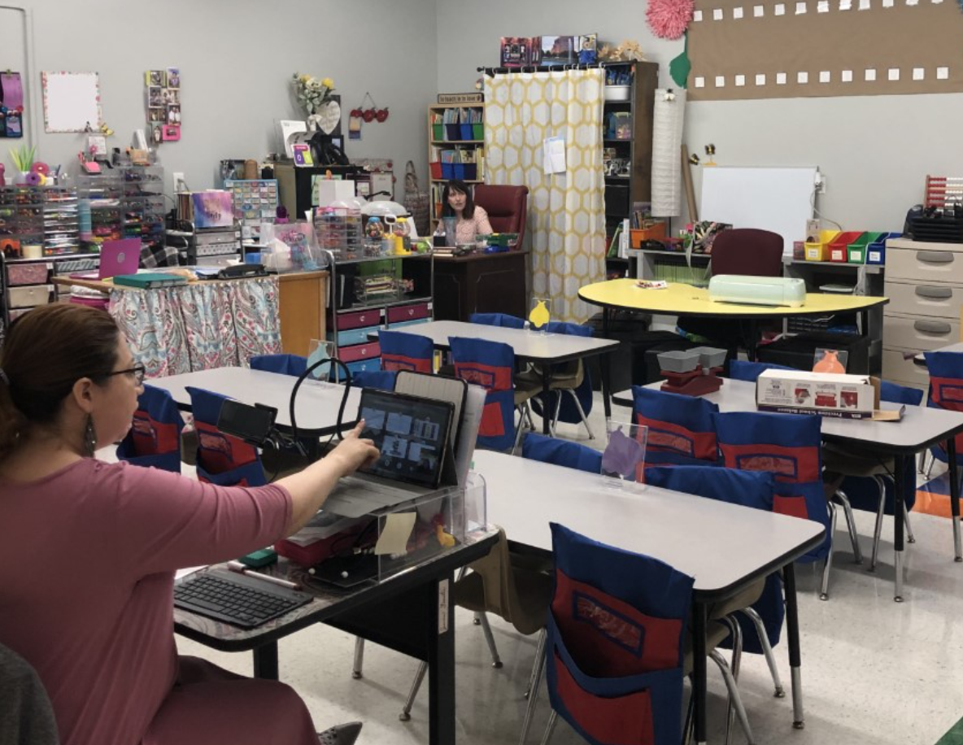
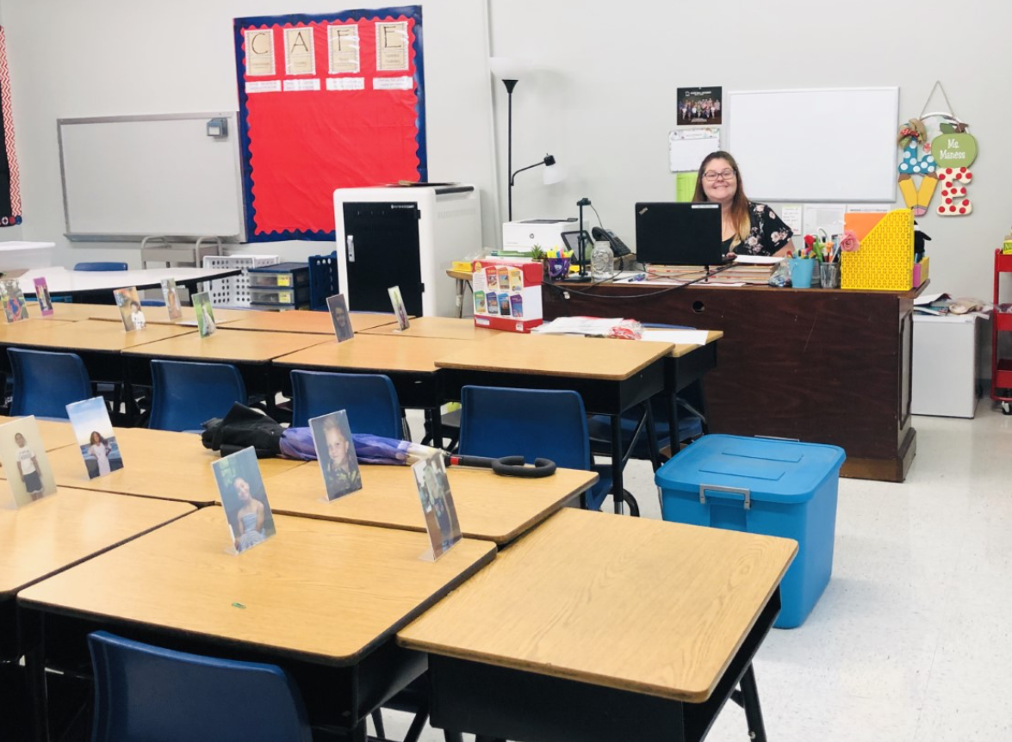
REMOTE LEARNING

Slide 7
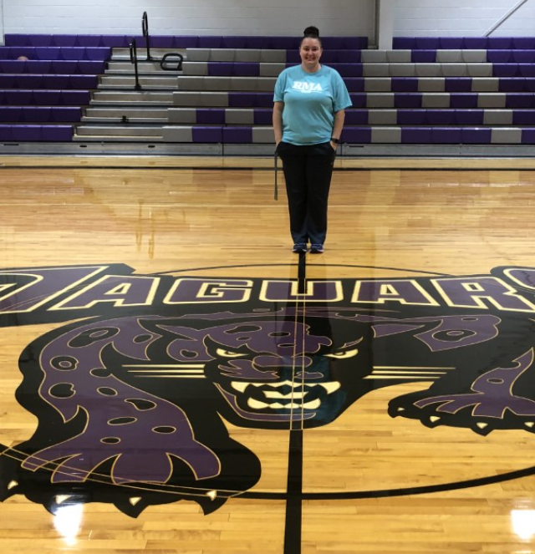
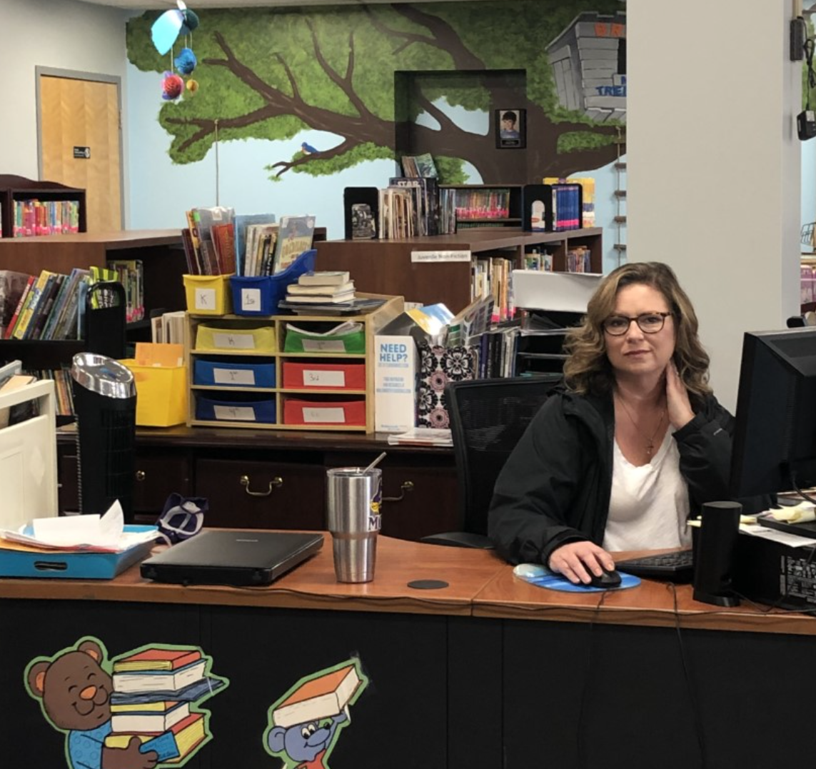
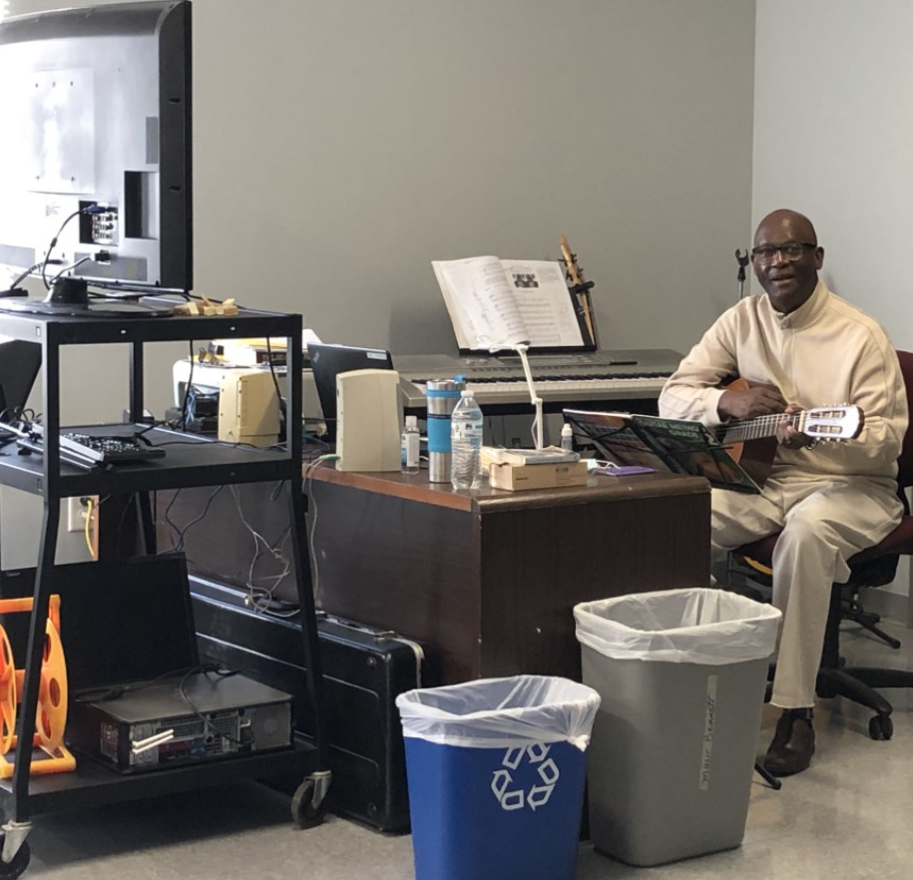
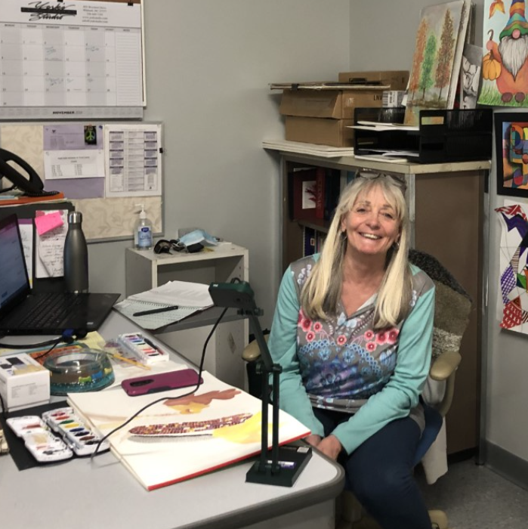
SPECIALS

Slide 8
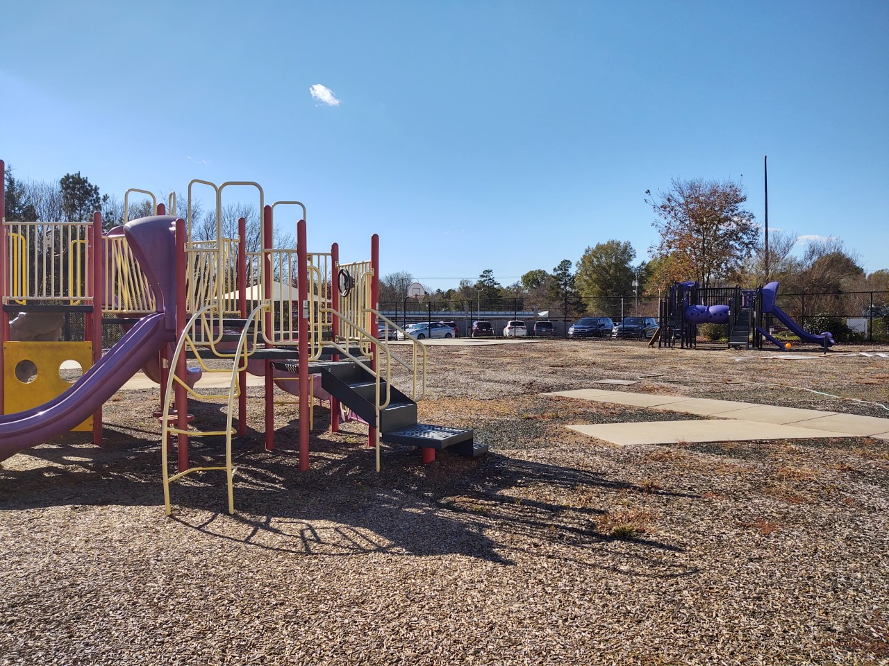

Slide 9
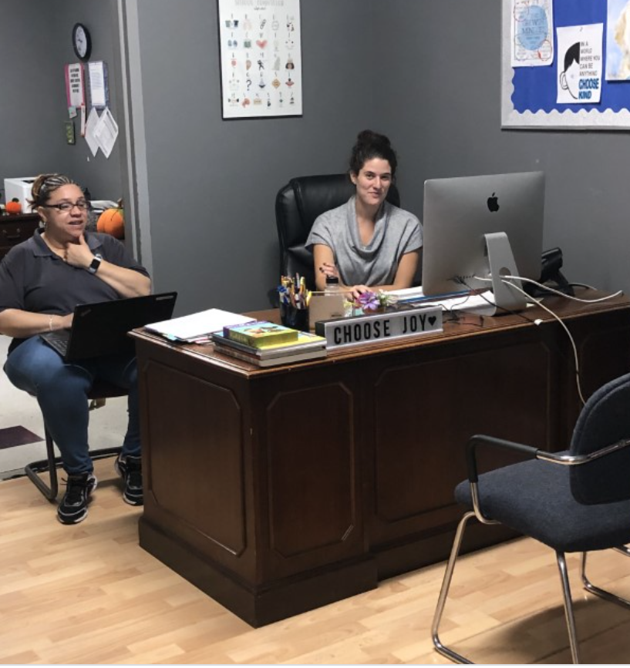
Student Support STAFF
Two full-time Exceptional Children’s “EC” Teachers
Full-time Reading Specialist
Part-time Occupational and Speech Therapists
School Counselor
Four school administrators

Slide 10
Middle School Schedule
Popular Elective Options
STEM
Horticulture
Spanish
Theater
Creative Writing
Art
Band
Oceanography
1st Elective: 7:45-8:32
2nd Elective: 8:35-9:20
1st Period: 9:23-10:30
2nd Period: 10:33-11:40
3rd Period: 11:43-12:10
Lunch: 12:10-12:35
3rd Period: 12:25-1:20
4th Period: 1:23-2:30

Slide 11
ELECTIVES

Slide 12
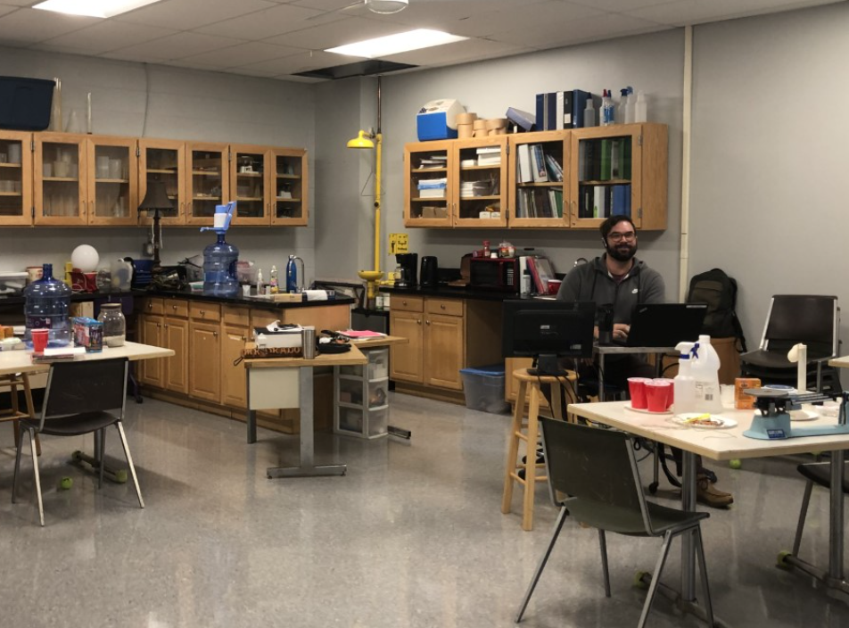
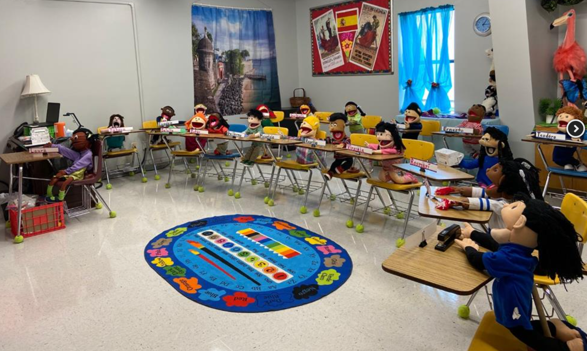
Middle School Remote Learning

Slide 13
High SCHOOL schedule
Block 1: 7:45 - 9:20
Block 2: 9:23 – 11:00
Block 3: 11:03 – 12:38
Lunch: 12:40 – 1:10
Block 4: 1:10 -2:30
Students have the opportunity to take classes through the North Carolina Virtual Public School, Alamance Community College, North Carolina School of Science and Math, at no additional cost.

Slide 14
Athletics
Fall Sports - Middle School |  | Fall Sports - High School
Boys & Girls Cross Country |  | Boys & Girls Cross Country
Boys & Girls Tennis |  | Girls Tennis
Girls Volleyball |  | Girls JV Volleyball
Cheerleading |  | Cheerleading
Boys Soccer |  | Girls Golf
 |  | Boys Soccer
Winter Sports - Middle School |  | Winter Sports - High School
Boys & Girls Basketball |  | Boys & Girls JV Basketball
Cheerleading |  | Boys & Girls Varsity Basketball
 |  | Swimming
 |  | Track
 |  | Cheerleading
Spring Sports - Middle School |  | Spring Sports - High School
Girls Softball |  | Girls Softball
Boys Baseball |  | Boys Baseball
Boys & Girls Tennis |  | Boys Tennis
Boys & Girls Golf |  | Boys Golf
Girls Soccer |  | Girls Soccer
 |  | Boys & Girls Track
Athletic teams participate in the North Carolina High School Athletic Association as a member of the Central Tar Heel Conference.

Slide 15
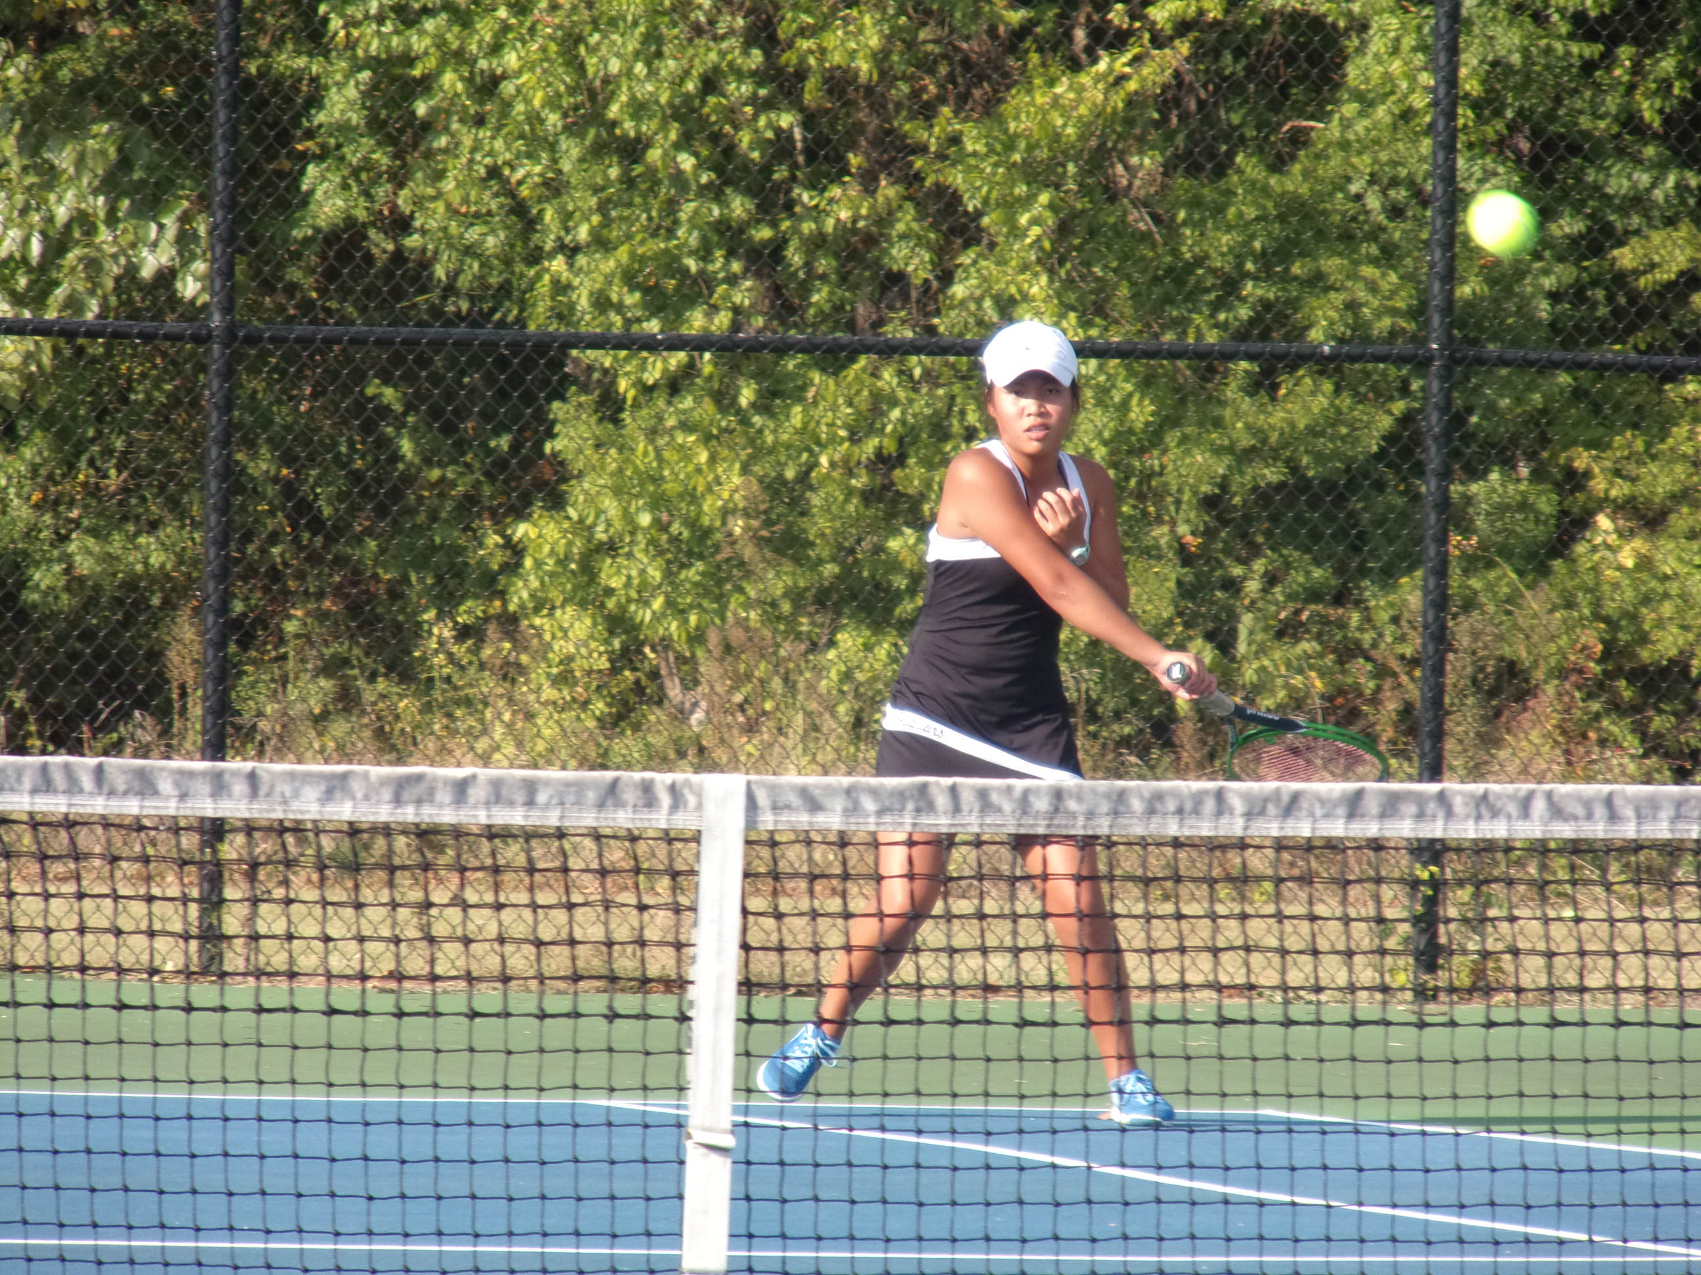

Slide 16
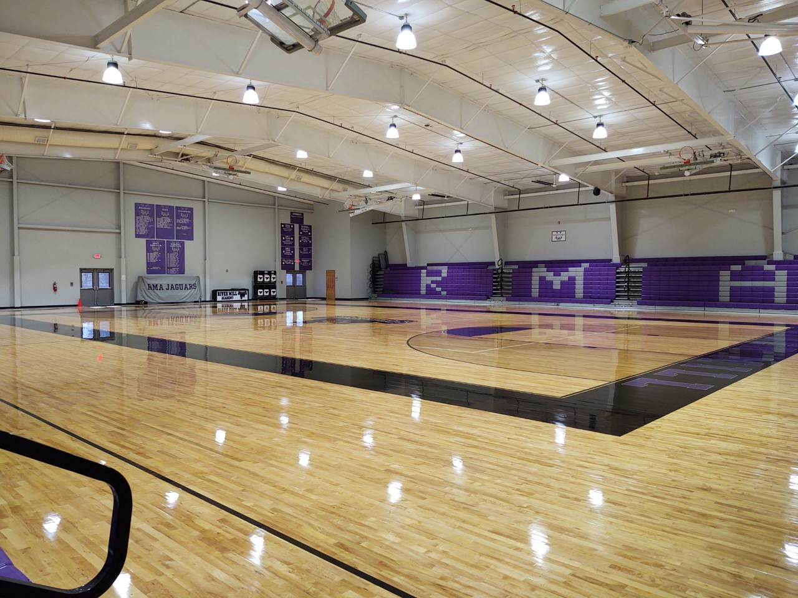

Slide 17
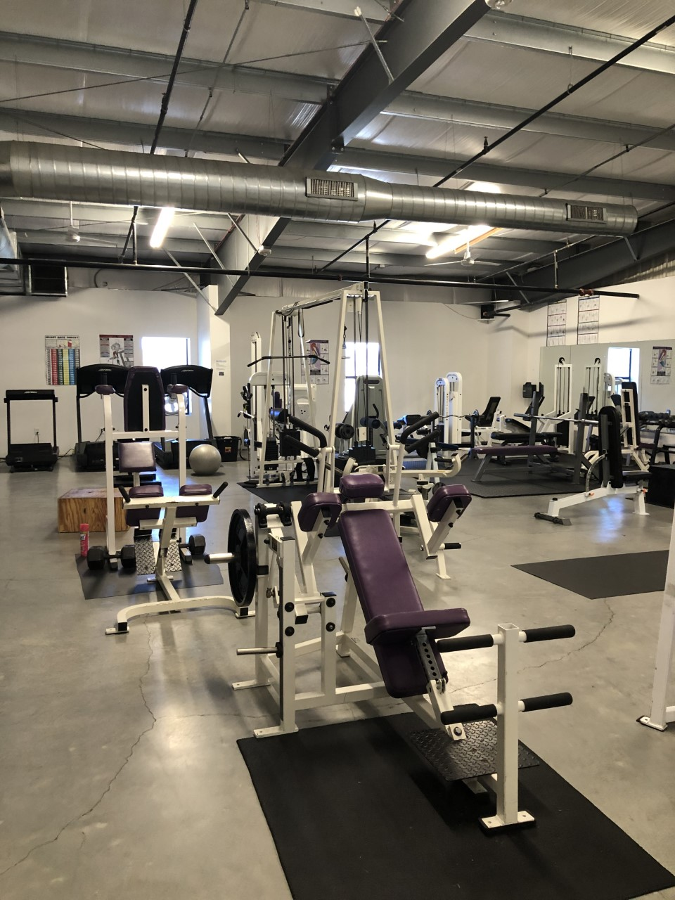
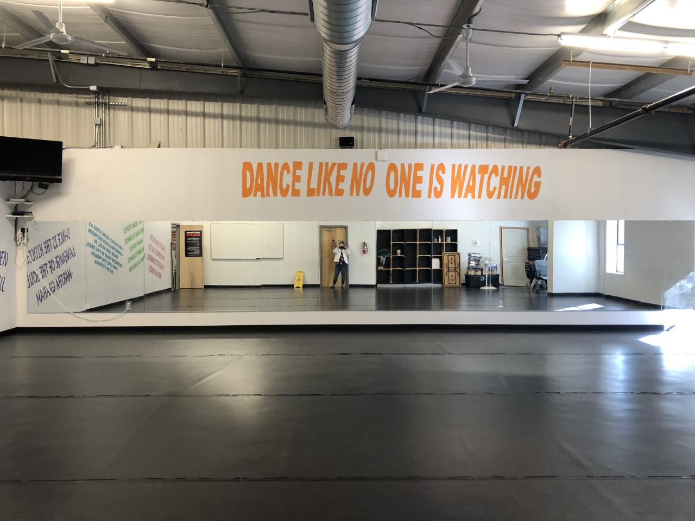

Slide 18
FAQ’s
Parent participation is encouraged and essential for our school to be successful.
PTT, Parents and Teachers Together
Four buses run in the morning and afternoons in a park and ride format
Two locations in Graham, one location in Burlington and Mebane.
Before and Afterschool Care is offered on-site.
Hours: 6:30 to7:30 AM and 2:30 to 6:30 PM
Lunch is catered by Danny’s Café for students who elect to purchase lunch.
Students in grades 8-12 receive a school issued Lenovo laptop.
2020-2021 Academic Calendar Link

Slide 19
Lottery
All students interested in enrolling at RMA must apply through the Lottery .
Lottery opens January 5th and closes February 12th at 3:30 pm, no applications will be accepted late.
Applications can be submitted and monitored through https://lotterease.com/
Siblings of currently enrolled students, along with staff member’s children, receive priority in the lottery and start the process at the top of the wait list.
On the day of the lottery, all students are randomly assigned a position on the wait list. Phone calls will be made to offer enrollment opportunities during the summer months as soon as they become available.
Openings vary per year school year, Kindergarten will have on average 60-70 openings.

Slide 20
Thank you for you time and interest!

